Slide 1
Regression Analysis
Regression Analysis in Practice
Nicoleta Serban, Ph.D.
Professor
School of Industrial and Systems Engineering
Predicting Churn Values of Customers: Regression & Variable Selection

Slide 2

About This Lesson

Slide 3
Logistic Regression
## Create full model
full.model <- glm(Churn.Value~ ., family = "binomial", data = train)
summary(full.model)
## Finding insignificant variables
which(summary(full.model)$coeff[,4]>0.05)
## The overall regression seems to have explanatory power
## Model Assessment: Multicollinearity
vifs <- vif(full.model)
Not statistically significant in the full model:
Gender, Senior Citizen, Phone Service, Multiple Lines, Internet Service, Online Security, Online Backup, Device Protection, Tech Support, Streaming TV, Streaming Movies, Payment Method, Monthly Charges

Slide 4
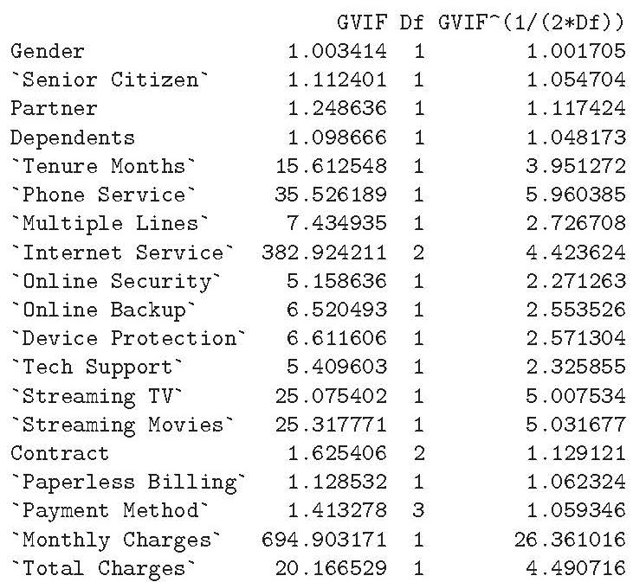
Logistic Regression (cont’d)
## Create full model
full.model <- glm(Churn.Value~ ., family = "binomial", data = train)
summary(full.model)
## Finding insignificant variables
which(summary(full.model)$coeff[,4]>0.05)
## The overall regression seems to have explanatory power
## Model Assessment: Multicollinearity
vifs <- vif(full.model)

Slide 5
Variable Selection
  Reduce the number of factors in the model
  Overfitting
    Model with large # of factors can fit too closely, cause random effects
    It can cause bad estimates
  Simplicity
    Less chance of insignificant factors
    Easier to interpret

Slide 6
Variable Selection (cont’d)
  Forward-Backward Stepwise Regression
  # Create minimum model including an intercept
  min.model <- glm(Churn.Value~ 1, family = "binomial", data = train)
  # Perform stepwise regression
  step.model <- step(min.model, scope = list(lower = min.model, upper = full.model),
  direction = "both", trace = FALSE)
Not selected: Gender, Senior Citizen, Online Backup, Device Protection, Monthly Charges
Not statistically significant: Payment Method by Mailed check and by Credit Card

Slide 7
Variable Selection (cont’d)
  LASSO Regression
  # Set predictors and response to correct format
  x.train <- model.matrix(Churn.Value ~ ., train)[,-1]
  y.train <- train$Churn.Value
  # Use cross validation to find optimal lambda
  cv.lasso <- cv.glmnet(x.train, y.train, alpha = 1, family = "binomial")
  # Train Lasso and display coefficients with optimal lambda
  lasso.model <- glmnet(x.train, y.train, alpha = 1, family = "binomial")
  coef(lasso.model, cv.lasso$lambda.min)
  Elastic Net Regression
  # Use cross validation to find optimal lambda
  cv.elnet <- cv.glmnet(x.train, y.train, alpha = 0.5, family = "binomial")
  # Train Elastic Net and display coefficients with optimal lambda
  elnet.model <- glmnet(x.train, y.train, alpha = 0.5, family = "binomial")
  coef(elnet.model, cv.elnet$lambda.min)
Not selected for both models: Monthly Charges

Slide 8

Summary

